Slide 1
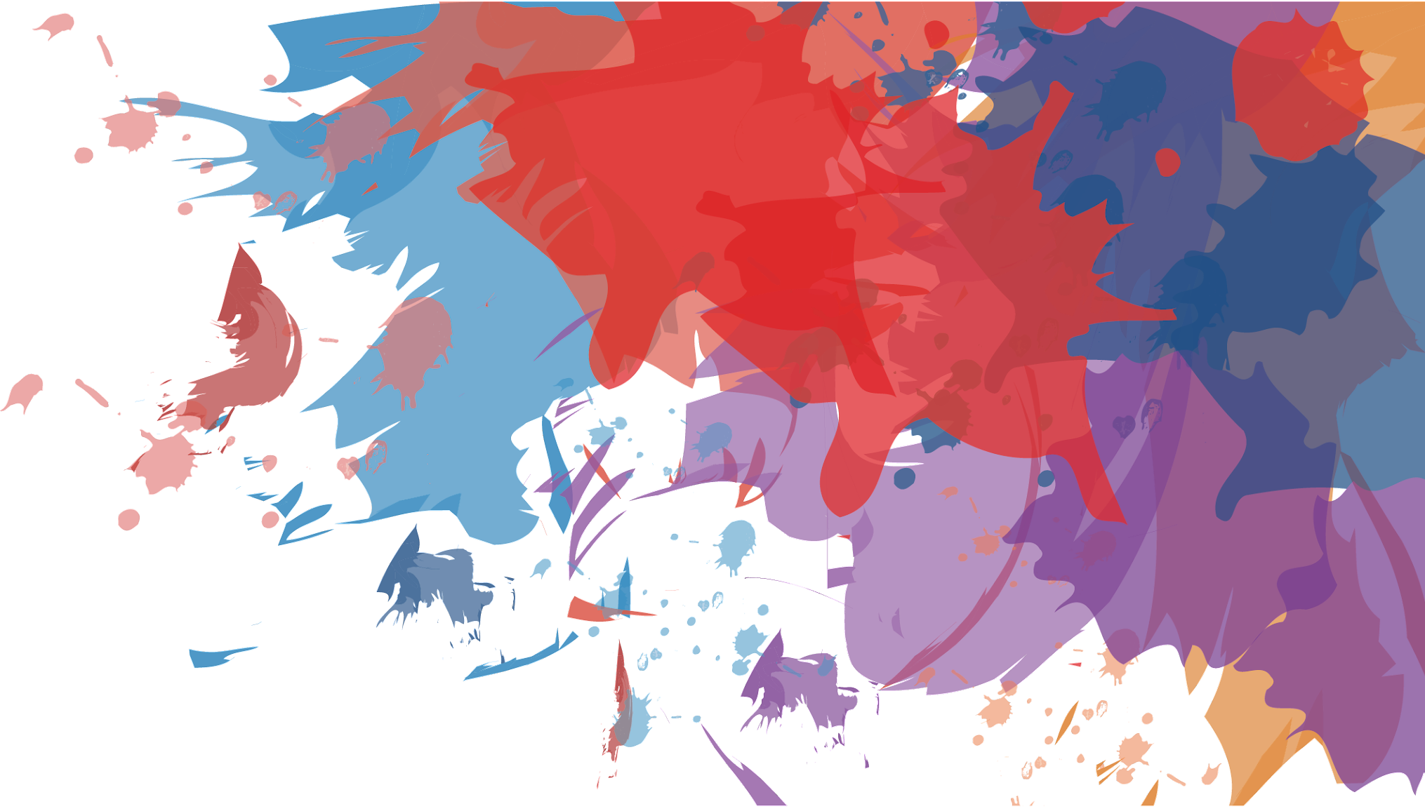
Wearable
Technology
By: Qixiao Zhang, Ketan Vanjani, Jay Patel

Slide 2
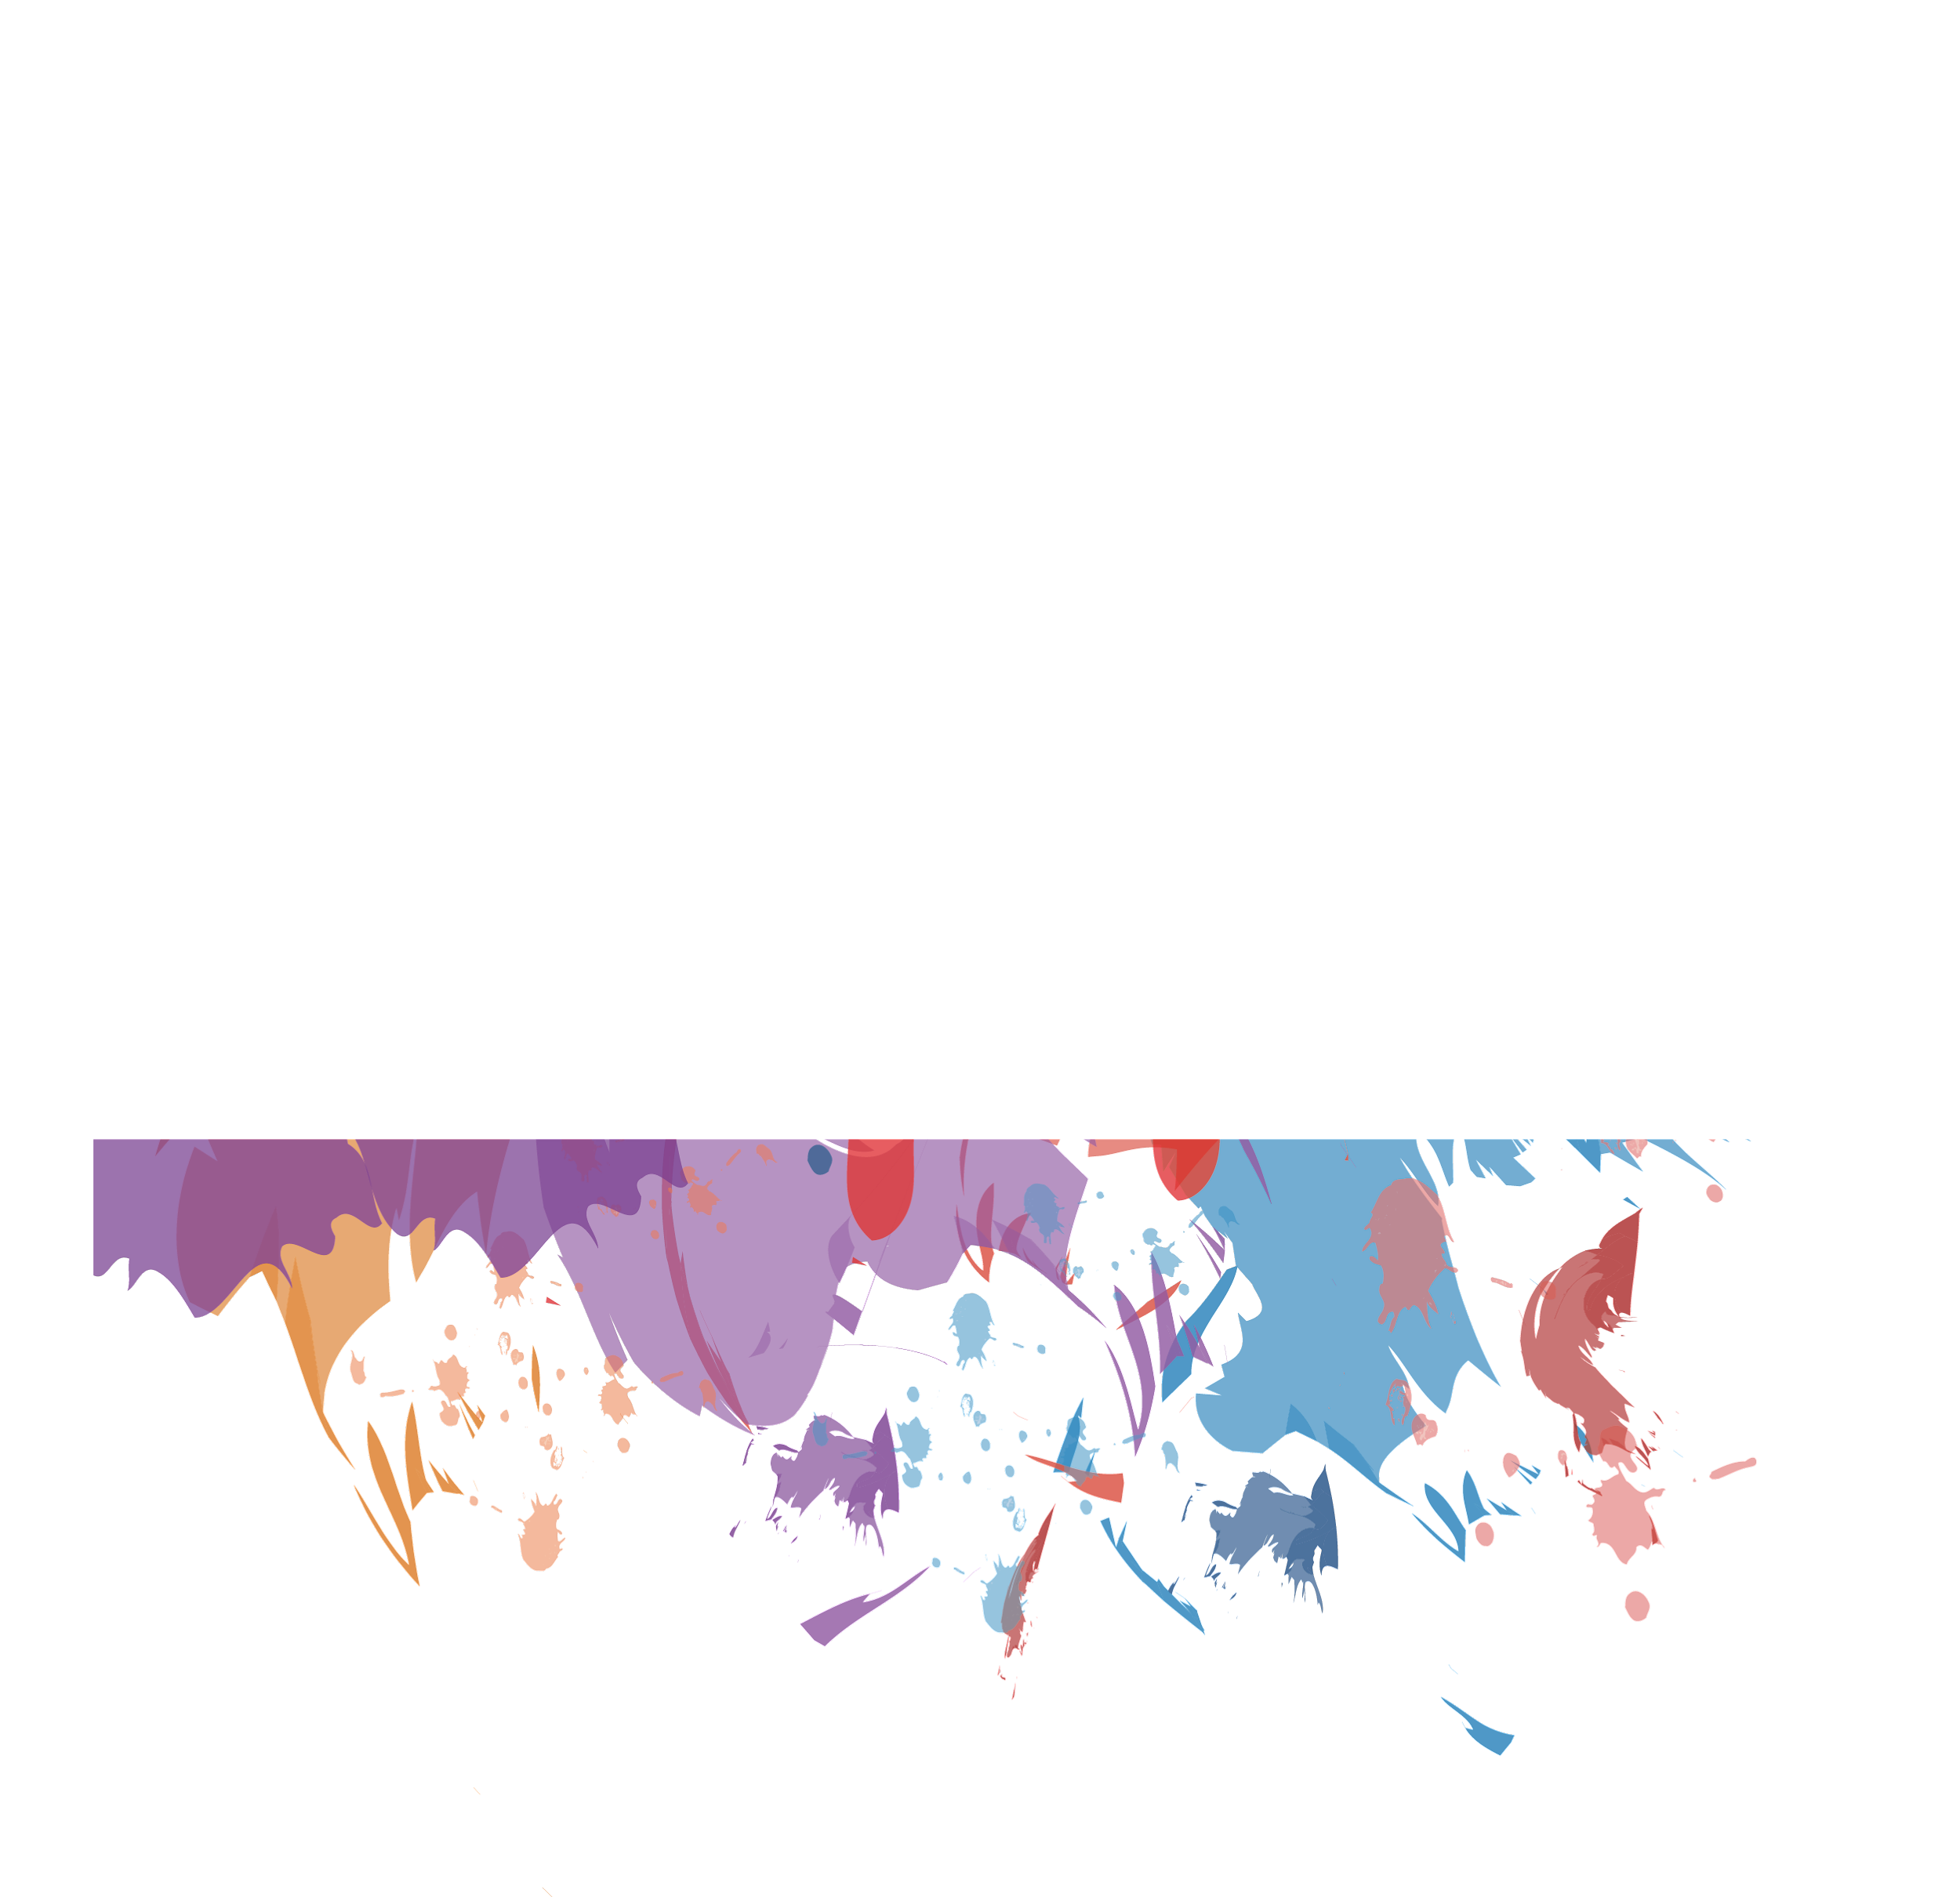
Contents
01
Mission Statement
02
Data Introduction
03
Model Construction
04
Results and Conclusion

Slide 3
PART 01
Mission Statement

Slide 4


Mission Statement
Goal?
People can control robotic prostheses with their minds.
How to do?
Machine Learning
What to do?
Identify the hand gesture with EMG signal
Why this?
Amputated people need prostheses to make their live more convenient
Notes:
In this project we try to accurately predict the hand gestures a subject performs. The reason for this is project is one day we hope to help those who have their hand amputated. With the use of resguial muscles like the forearm we believe that we will be able to predict hand gestures with the use of an EMG. An EMG also known as electromyography is the idea of measuring muscle activity. In this project we use an accelerometers that will pick up on muscle activity

Slide 5
PART 02
Data Introduction

Slide 6
Data Intro
Ninapro is a publicly available multimodal database to foster research on robotic & prosthetic hands controlled with artificial intelligence.
Ninapro includes electromyography, kinematic, inertial, eye tracking, visual, clinical and neurocognitive data.
Ninapro data are used worldwide by scientific researchers in machine learning, robotics, medical and neurocognitive sciences.

Slide 7
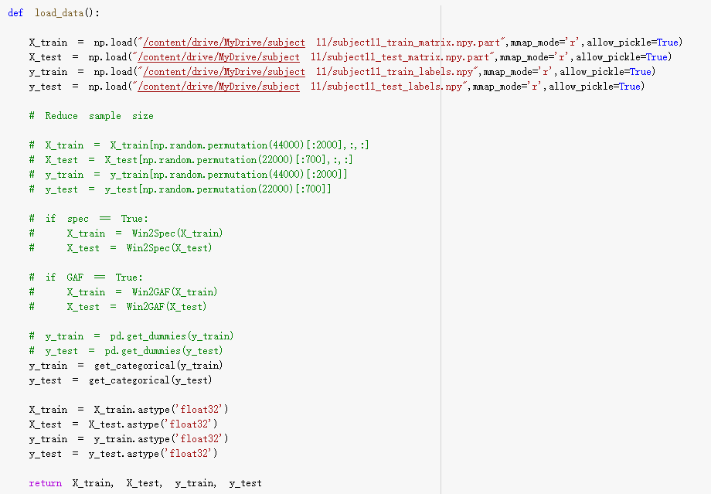
Data Intro
Load
Data
Data set has three dimensions:
(samples, windows, channels)
Notes:
12 channels, each one has 600
600 data per window
Data we used are just a part of them

Slide 8
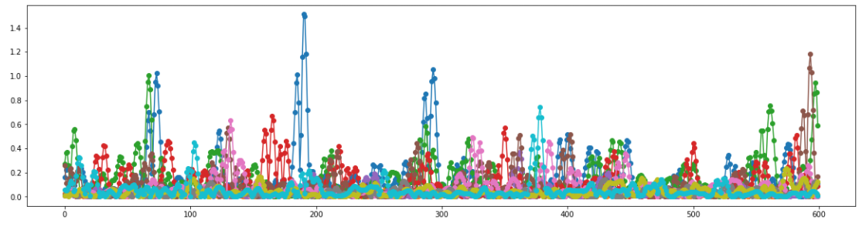
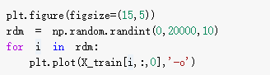
Data Intro
Data Preview

Slide 9

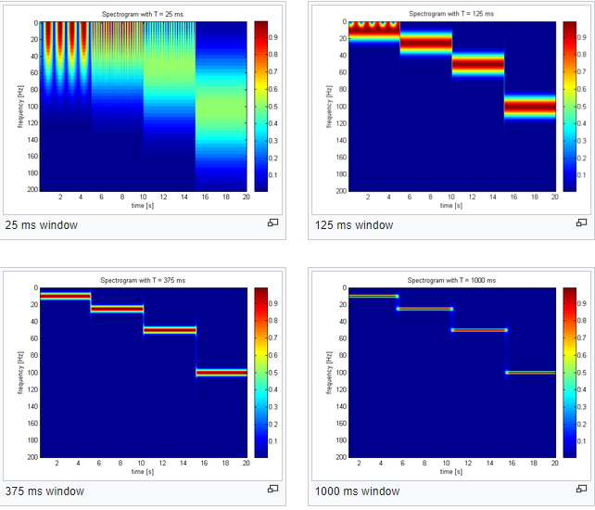
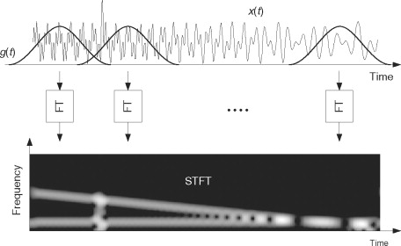

Short Time Fourier Transform (STFT)
The STFT is a Fourier Transform technique used to determine the frequency and phase of certain sections of a given signal.
This gives a Fourier spectrum, which is often then viewed on a spectrogram.
Python Command:
scipy.signal.stft(x,window='hann'...)

Slide 10
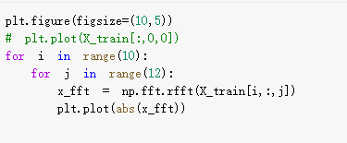
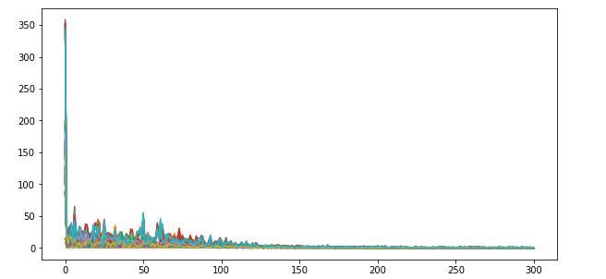
Implement FFT on the data

Slide 11
PART 03
Model Construction

Slide 12
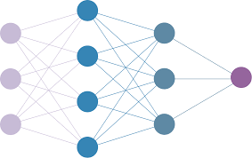
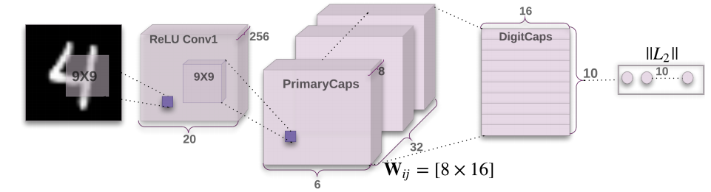
Network
Neural Network
A neural network is a series of algorithms that endeavors to recognize underlying relationships in a set of data through a process that mimics the way the human brain operates.
Convolutional Neural Network
In deep learning, a convolutional neural network (CNN, or ConvNet) is a class of artificial neural network, most applied to analyze visual imagery.
CapsNet
A Capsule Neural Network (CapsNet) is a machine learning system that is a type of artificial neural network (ANN) that can be used to better model hierarchical relationships. The approach is an attempt to more closely mimic biological neural organization.
Notes:
The idea is to add structures called “capsules” to a convolutional neural network (CNN), and to reuse output from several of those capsules to form more stable (with respect to various perturbations) representations for higher capsules.^{[2]} The output is a vector consisting of the probability of an observation, and a pose for that observation. This vector is similar to what is done for example when doing classification with localization in CNNs.
Posted in 2017, Geoffrey Hinton

Slide 13
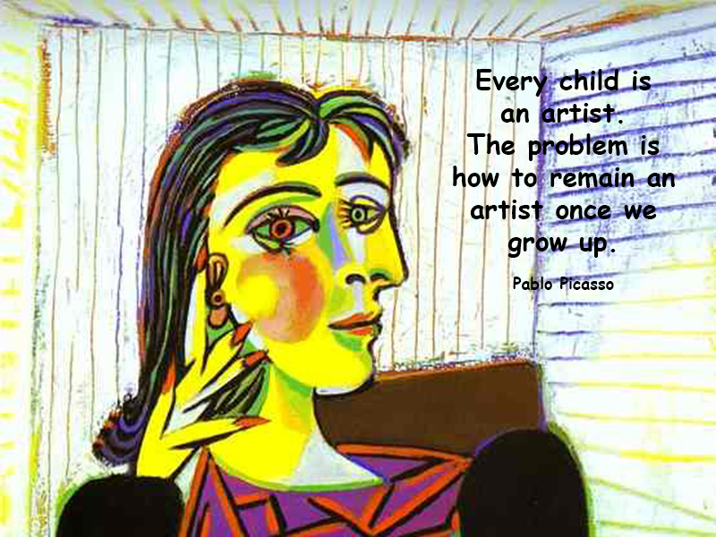
CNN vs CapsNet
CapsNet
CNN
Lack of context
Output is a vector
If the beak is located on the tail, for example, the classifier will still consider the image as one of a bird (although, obviously, no bird carries its beak on its tail).
Capsule gives us a vector as an output that has a direction. Overcome all the drawbacks that are present on CNN.
Information loss
Fewer data, Better results
by which meaningful pixels (or neurons) are discarded since max pooling only select one neuron or one pixel from a cluster.
Need fewer data to train same model
Notes:
Among other benefits, capsnets address the "Picasso problem" in image recognition: images that have all the right parts but that are not in the correct spatial relationship

Slide 14
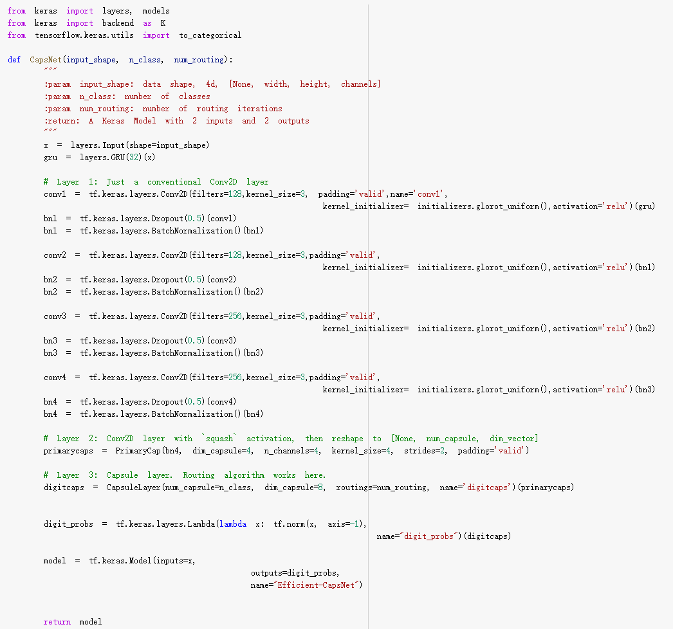
CapsNet Code
Conv Layer
(ReLU)
Primary Cap
Digit Caps
Digit Probs

Slide 15
PART 04
Results and Conclusion

Slide 16
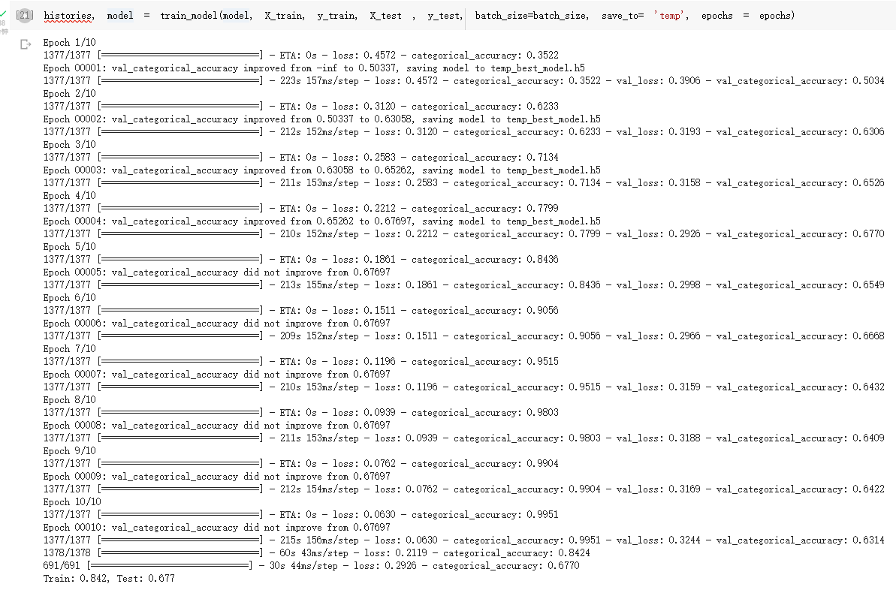
Model training

Slide 17
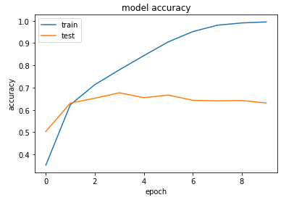
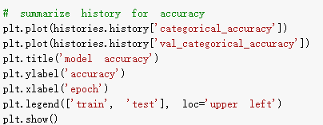
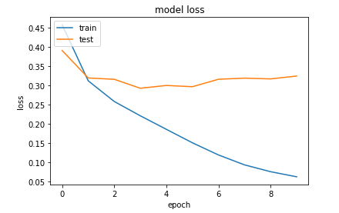
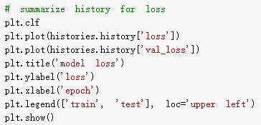
Model training

Slide 18
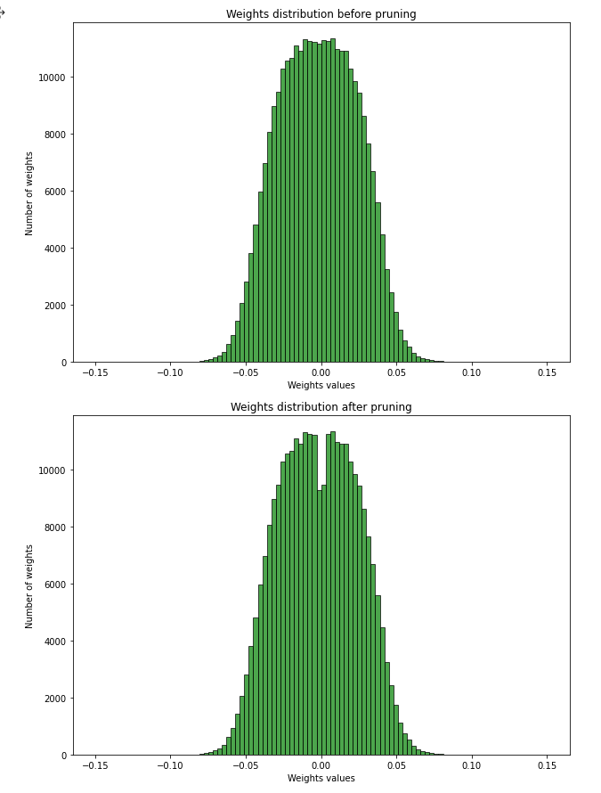
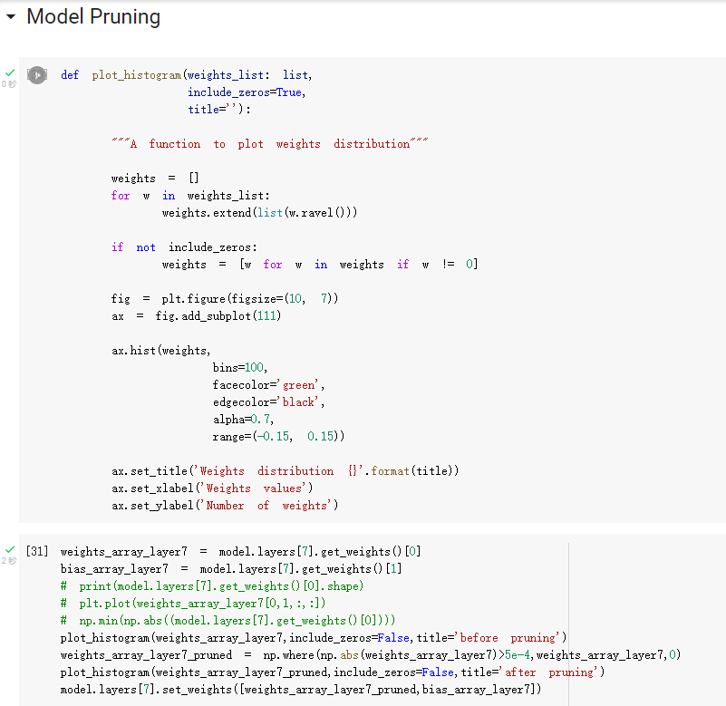
Model Pruning to specific layer

Slide 19
Model Pruning to specific layer
Before Pruning:
After Pruning:

Slide 20
Reference
Big Thanks To:
Professor S. Farokh Atashzar, Werable Technology VIP Softwear Team
“Papers with Code - Ninapro DB2 Dataset.” NinaPro DB2 Dataset | Papers With Code, https://paperswithcode.com/dataset/ninapro-db2.
Atzori, M., Gijsberts, A., Castellini, C. et al. Electromyography data for non-invasive naturally-controlled robotic hand prostheses. Sci Data 1, 140053 (2014). https://doi.org/10.1038/sdata.2014.53
Wang, Yiwei et al. “Multitask CapsNet: An Imbalanced Data Deep Learning Method for Predicting Toxicants.” ACS omega vol. 6,40 26545-26555. 29 Sep. 2021, doi:10.1021/acsomega.1c03842

Slide 21
Thank you

